Slide 1
7th Grade Reading
Mrs. Muench
Wife, mother, teacher, friend
4 Degrees – including Reading Specialist
Have taught 6-12 grade and at the collegiate level
Taught: Reading, English, Social Studies, Arts and Humanities, Speech, Sociology, Human Resources, Strategies for Success

Slide 2
What is This Reading Class???
Fluency – Speed of reading – reading whole sentences without hesitation
Phonics – Learning to pronounce the words
Comprehension – Understanding what we read
Visualization – Seeing what we read – like a movie
Inferences – Making logical guesses
Understanding the Elements of the Short Story to better help us
understand the story

Slide 3
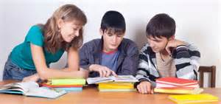
Goals of this Class
Become proficient readers
Enjoy reading/read
Make school easier – good readers do better in school
Learn to collaborate with others – even those we aren’t “friends” with
Enjoy reading!!!!!!

Slide 4
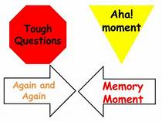
How will I help you be successful?
I will create the best lessons I can
I will push you and have high expectations of you
We will read daily for 10 minutes – orally to a partner – each person
We will keep data notebooks to plot your progress
I will teach you new strategies to help you be a better reader
Phonics – learning how to break words apart to read each word
Fluency – speed of reading
Signposts – What to look for when reading
Elements of the Short Story – Almost all stories follow this!

Slide 5
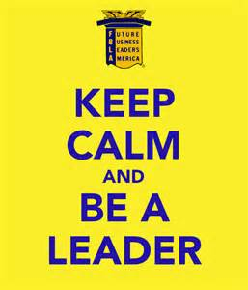
What Can You Do to Become a Better Reader?
READ, READ, and READ some more
Read a minimum of 20 minutes per NIGHT
Come prepared – that means bring a book to read and a pencil
Bring a good attitude
Be positive and follow the rules
Have high expectations of others and yourself
Work the entire time you are here
Trust me and practice what you learn in here in all your classes
BE A LEADER!!!!!

Slide 6
Class Expectations
Come prepared – bring a book to read EVERY DAY and a pencil
Did I mention bring a pencil???
Bring a good attitude
Respect yourself and others
Take care of all property in this room – clean up after yourself
Have high expectations of yourself and others – nicely let others know
when they are off task
Ask questions and participate
Be ready to work the moment you come in – that means someone passes out the folders and sit with your partner and begin reading the book we are reading as soon as you get in. You don’t need to wait for me.

Slide 7
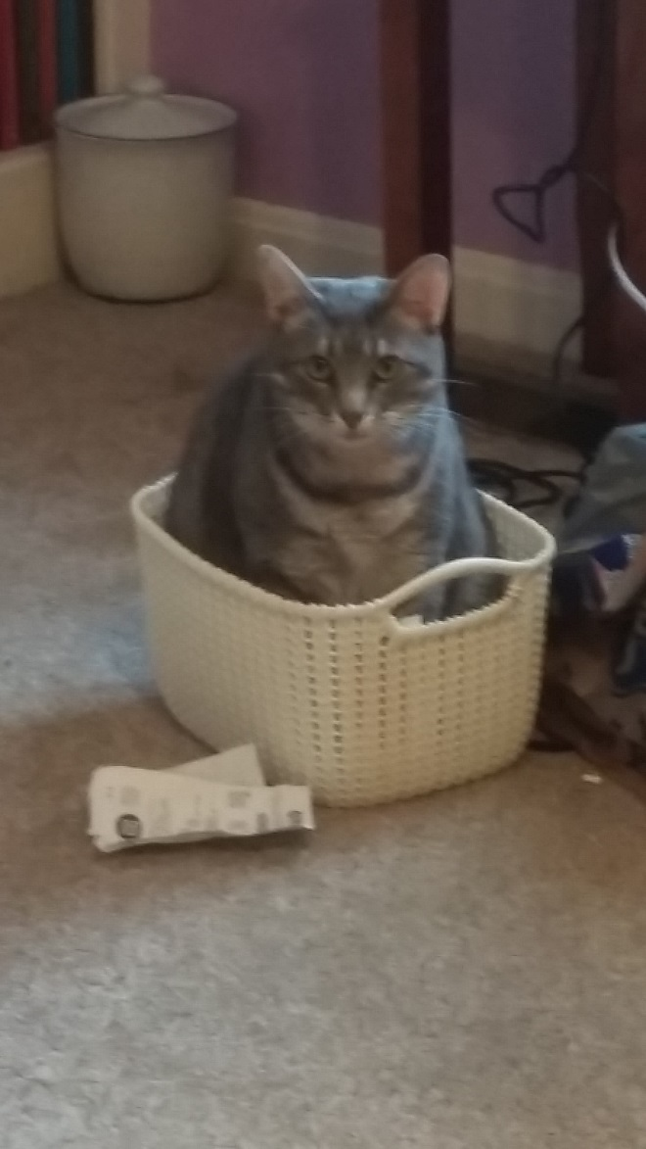
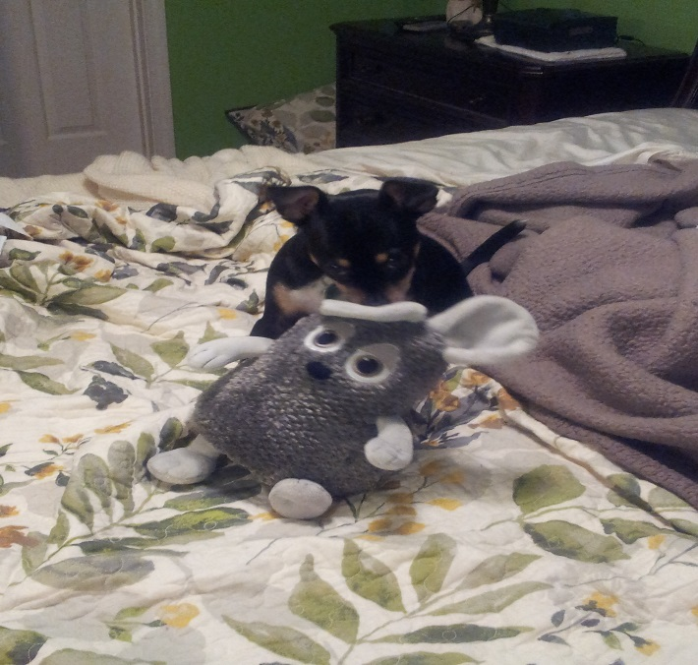
Who are you? Answer the following questions:
How do you feel about reading?
What is your goal for this class?
Any idea what you want to do in the future?
List at least 3 things you want others to know about you.

